Slide 1
Weekly report: Feedback Controller
Week number: 04
Date: 21/10/2025
Supervisor: Prof. Dr.-Ing. David Schlipf
Group members: Mirza Dincer, Saurabh Pankaj Jha
Presenter: Mirza Dincer

Slide 2
List of Contents
Tasks of the Week
Steady State Values
DLC 1.2 Simulations
Simulation Settings
Results
Conclusion
Mirza Dincer - 780261

Slide 3
Tasks of the Week
Setting MATLAB script to get a steady state pitch and rotor speed values of a turbine
Setting MATLAB scripts to run a DLC 1.2 simulations
Running a DLC 1.2 simulations for IEA 3.4 MW.
Mirza Dincer - 780261

Slide 4
Steady State Values
Wind Speed | Blade Pitch | Rotor Speed
4 | 0.000 | 4.645
5 | 0.000 | 5.807
6 | 0.000 | 6.967
7 | 0.000 | 8.128
8 | 0.000 | 9.288
9 | 0.294 | 10.432
10 | 3.361 | 11.634
11 | 7.107 | 11.634
12 | 9.493 | 11.634
13 | 11.456 | 11.634
14 | 13.184 | 11.634
15 | 14.763 | 11.634
16 | 16.240 | 11.634
17 | 17.639 | 11.634
18 | 18.973 | 11.634
19 | 20.234 | 11.634
20 | 21.461 | 11.634
21 | 22.649 | 11.634
22 | 23.801 | 11.634
23 | 24.910 | 11.634
24 | 25.992 | 11.634
25 | 27.046 | 11.634
26 | 28.073 | 11.634
27 | 29.074 | 11.634
28 | 30.050 | 11.634
29 | 31.003 | 11.634
30 | 31.935 | 11.634
Steady state values ensures more stable turbine startup in simulation.
Only enabled GenDOF and First fore-aft tower bending-mode DOF.
No initial conditions.
600 second sim with constant wind speeds.
Average values of last 60 seconds to get the settled values.
Steady State Values of Pitch angle and Rotor speed for IEA 3.4 MW
Mirza Dincer - 780261

Slide 5
DLC 1.2 simulations
DLC 1.2 simulations are for production in normal turbulence to evaluate fatigue for the lifetime of a turbine.
As a result, table with following values are generated
Mean value of generated power
DEL values for tower base pitching moment (TwrBsMyt)
DEL values Low-speed shaft torque (RotTorq)
DEL values Flapwise moment at the blade root (RootMyb1)
Pitch travel
Max value of Electrical generator torque (GenTq)
Mirza Dincer - 780261

Slide 6
Simulation Settings
660 seconds of simulation. Evaluation of values starts at t = 60 second to get settled values.
DLC 1.2 wind fields with average of 4 m/s to 24 m/s with steps with 2 m/s, 6 seeds.
Only enabled Rotor DOF, First and Second fore-aft tower bending-mode DOF, First and Second side-to-side tower bending-mode DOF.
Initial conditions of pitch angle and rotor speed for every corresponding wind speed.
Running only feedback controller, no Lidar-assisted controller.
Mirza Dincer - 780261

Slide 7
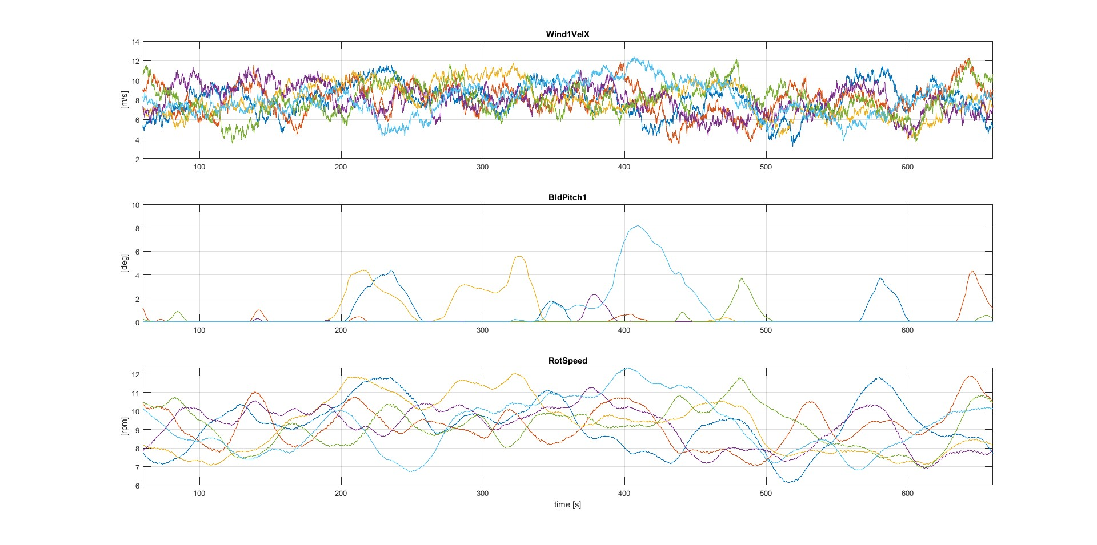
Result 1
Simulation results for IEA 3.4 MW with feedback control. 8 m/s wind field for DLC 1.2
Mirza Dincer - 780261

Slide 8
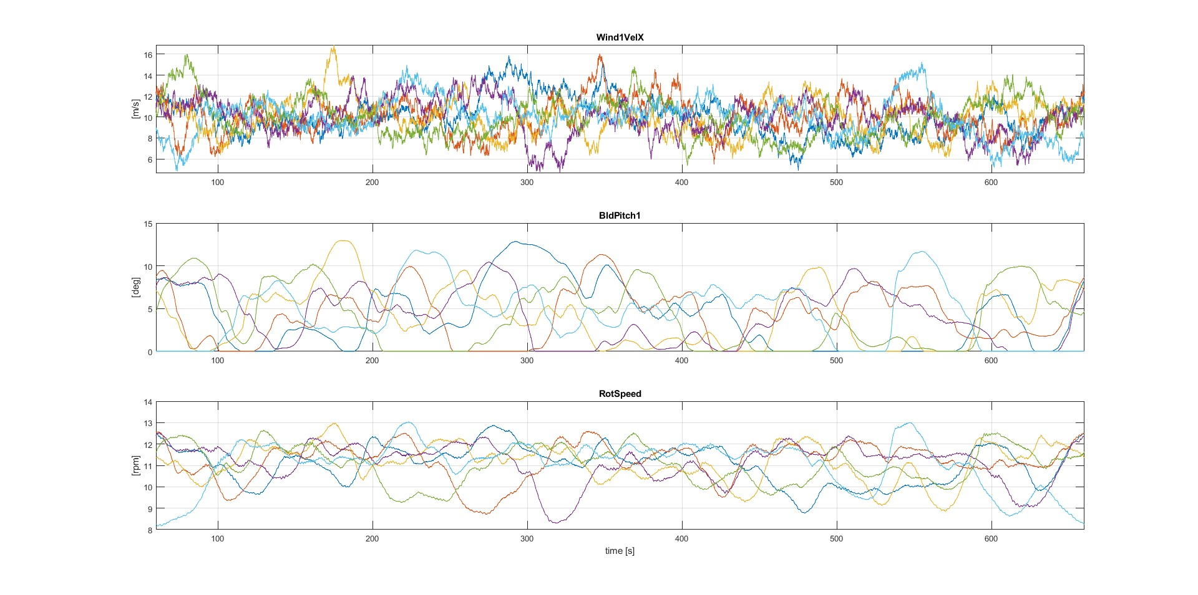
Result 2
Simulation results for IEA 3.4 MW with feedback control. 10 m/s wind field for DLC 1.2
Mirza Dincer - 780261

Slide 9
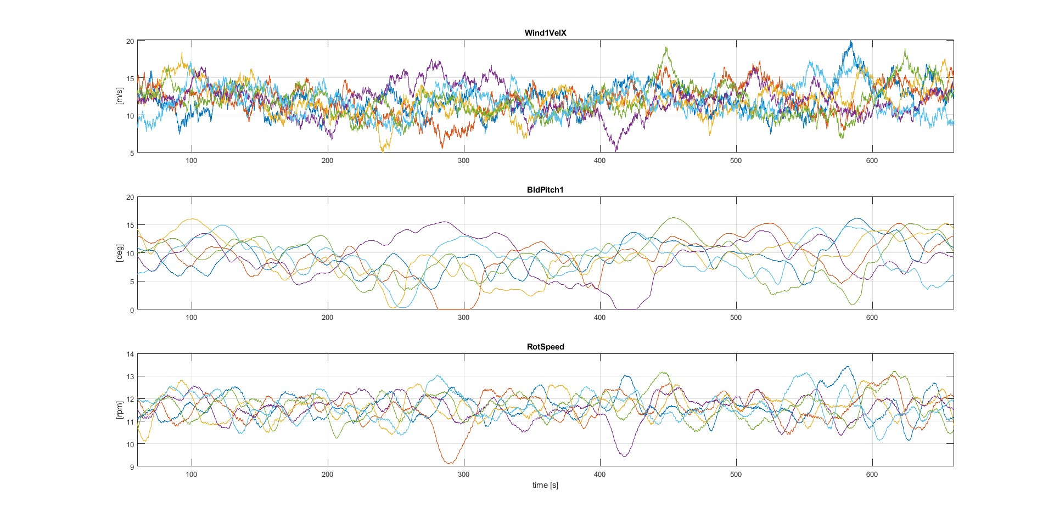
Result 3
Simulation results for IEA 3.4 MW with feedback control. 12 m/s wind field for DLC 1.2
Mirza Dincer - 780261

Slide 10
DLC 1.2 Result Table
Wind Speed | GenPwr | DEL_4_TwrBsMyt | DEL_4_RotTorq | DEL_10_RootMyb1 | Overshoot_GenSpeed | Travel_BldPitch1 | max_GenTq
4 | 231.33 | 3.69E+04 | 6.69E+02 | 2.70E+03 | 77.89 | 0.00 | 8.79
6 | 804.38 | 8.21E+04 | 1.40E+03 | 5.39E+03 | 116.36 | 0.00 | 19.20
8 | 1855.78 | 1.02E+05 | 2.21E+03 | 7.68E+03 | 151.21 | 15.62 | 28.98
10 | 2969.43 | 8.80E+04 | 2.27E+03 | 9.17E+03 | 162.95 | 107.27 | 29.08
12 | 3308.06 | 8.28E+04 | 2.29E+03 | 9.83E+03 | 166.29 | 126.80 | 29.08
14 | 3308.06 | 8.28E+04 | 2.29E+03 | 9.83E+03 | 166.29 | 126.80 | 29.08
16 | 3350.12 | 1.02E+05 | 2.89E+03 | 1.18E+04 | 177.56 | 96.03 | 29.08
18 | 3354.51 | 1.10E+05 | 3.28E+03 | 1.28E+04 | 186.26 | 87.54 | 29.08
20 | 3346.44 | 1.32E+05 | 4.01E+03 | 1.40E+04 | 190.78 | 89.57 | 29.08
22 | 3346.27 | 1.37E+05 | 4.50E+03 | 1.42E+04 | 192.71 | 100.81 | 29.08
24 | 3348.98 | 1.49E+05 | 5.01E+03 | 1.51E+04 | 195.36 | 113.40 | 29.08
Result Table of DLC 1.2 simulations for IEA 3.4 MW
Original table has values for every wind field seeds, mean of seed is shown for presentation
Mirza Dincer - 780261

Slide 11
Conclusion
Script for getting steady state values of pitch angle and rotor speed of a wind turbine
Successfully run a simulation of DLC 1.2
Next week:
check step response for pitch and torque controller​
Focus on getting EOG at 12 m/s and 25 m/s better in cost by changing KP and updating KP and KI vectors in Rosco​
Mirza Dincer - 780261

